Slide 1
My Perimeter, Area and Volume Interactive Notebook
Name
Class
Term 3 Semester 2

Slide 2
Contents
Formula Page
Page
Date
Description
2
3

Slide 3
Tasks
24
7
30
Essential Question
Questions
Notes
Summary
18
19

Slide 4
24
7
30
Date
Cubes and Rectangular Prisms
EQ – How is a net of a 3-D shape used to find the surface area and volume of a rectangular prism?
19

Slide 5
24
7
30
Date
Cubes and Rectangular Prisms
EQ – How is a net of a 3-D shape used to find the surface area and volume of a rectangular prism?
A net is a 2-D picture that folds to make a 3-D shape.
19

Slide 6
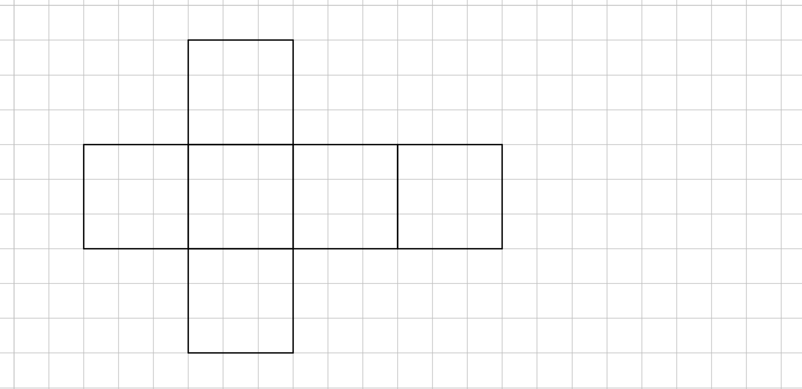
24
7
30
Date
Cubes and Rectangular Prisms
EQ – How is a net of a 3-D shape used to find the surface area and volume of a rectangular prism?
A net is a 2-D picture that folds to make a 3-D shape.
19

Slide 7
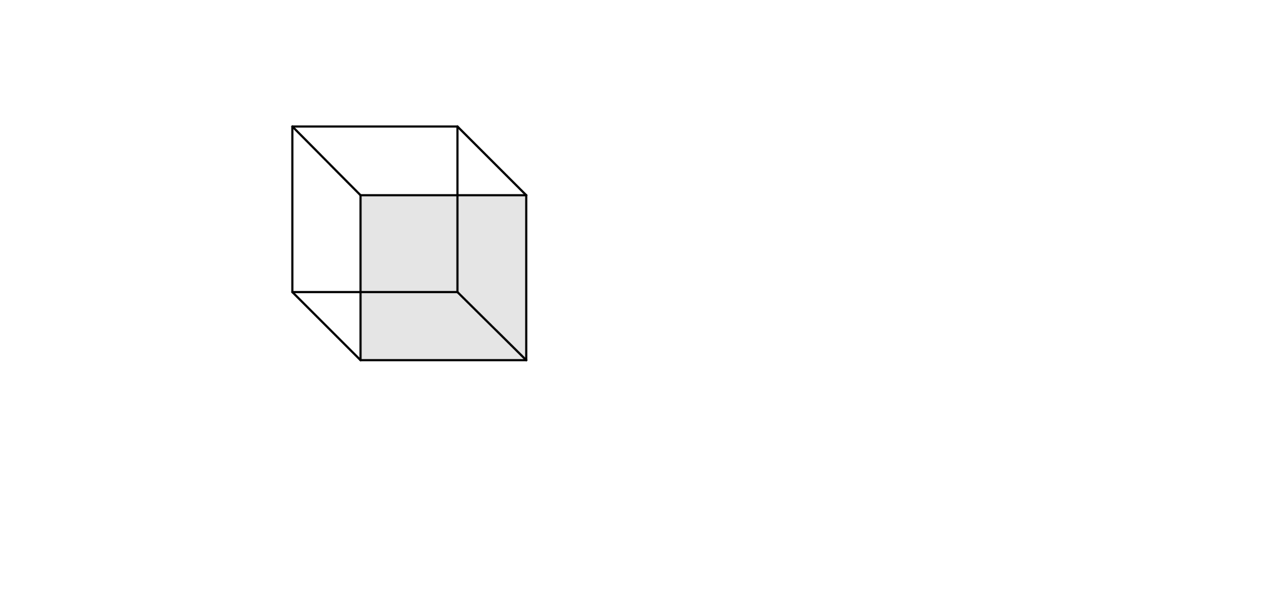
24
7
30
Date
Cubes and Rectangular Prisms
EQ – How is a net of a 3-D shape used to find the surface area and volume of a rectangular prism?
A net is a 2-D picture that folds to make a 3-D shape.
19

Slide 8
24
7
30
Date
Cubes and Rectangular Prisms
EQ – How is a net of a 3-D shape used to find the surface area and volume of a rectangular prism?
A net is a 2-D picture that folds to make a 3-D shape.
Edge
Vertex
Face
19

Slide 9
24
7
30
Date
Cubes and Rectangular Prisms
EQ – How is a net of a 3-D shape used to find the surface area and volume of a rectangular prism?
Activity – cut out the net of the cube
19

Slide 11
Working -
Area of each face =
Faces
Total Surface Area =
Name
12 Edges
Vertices
Sketch
Volume =
Total Surface
Area (TSA)=
Volume =

Slide 12

Cube

Slide 13
6 Faces
All congruent
squares
Cube
12 Edges
.
8 Vertices
.

Slide 14
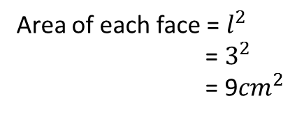
Area of each face = $l^{2}$
= $3^{2}$
= 9${cm}^{2}$
6 Faces
All congruent
squares
Cube
12 Edges
.
8 Vertices
.
Total Surface
Area (TSA)=

Slide 15
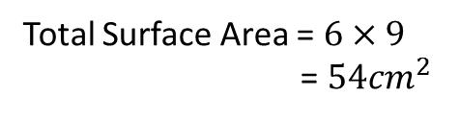
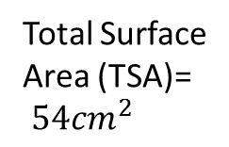
Area of each face = $l^{2}$
= $3^{2}$
= 9${cm}^{2}$
6 Faces
All congruent
squares
Total Surface Area = $6×9$
= $54{cm}^{2}$
Cube
12 Edges
.
8 Vertices
.
Total Surface
Area (TSA)=
$54{cm}^{2}$

Slide 16
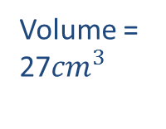
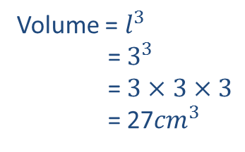
Area of each face = $l^{2}$
= $3^{2}$
= 9${cm}^{2}$
6 Faces
All congruent
squares
Total Surface Area = $6×9$
= $54{cm}^{2}$
Cube
12 Edges
.
8 Vertices
.
Volume = $l^{3}$
= $3^{3}$
= $3×3×3$
= 27${cm}^{3}$
Total Surface
Area (TSA)=
$54{cm}^{2}$
Volume =
27${cm}^{3}$

Slide 17


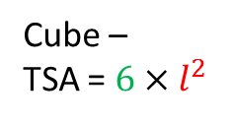
24
7
30
Date
Cubes and Rectangular Prisms
EQ – How is a net of a 3-D shape used to find the surface area and volume of a rectangular prism?
$$l$$
To find the surface area you add together the areas of all the faces
TSA is Total Surface Area
Cube –
TSA = $6×l^{2}$
Number of faces x
Area of each face
Volume = $l^{3}$
19

Slide 18
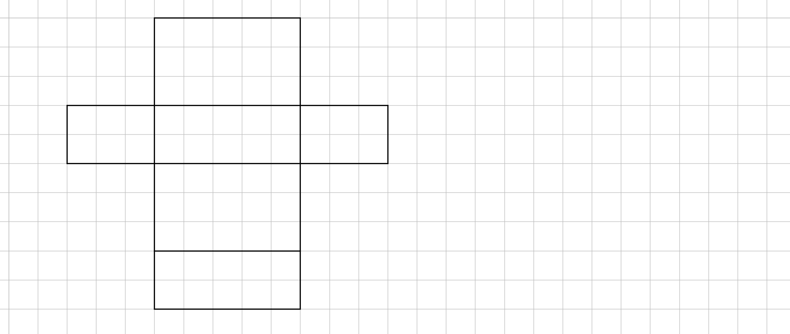
Rectangular Prism
Working -
Area of each face =
Faces
Vertices
12 Edges
Name
Sketch
Total Surface
Area (TSA)=
Total Surface Area =
Volume =
Volume =

Slide 19
Rectangular Prism
Working -
Area of each face =
Faces
Vertices
Rectangular prism
Edges
Total Surface
Area (TSA)=
Total Surface Area =
Volume =
Volume =

Slide 20
Rectangular Prism
Working -
Area of each face =
6 Faces
6 rectangles
3 sizes – 2 of each
8 Vertices
Rectangular prism
12 Edges
Total Surface
Area (TSA)=
Total Surface Area =
Volume =
Volume =

Slide 21
Rectangular Prism
Working -
1
Area of each face –
6 Faces
6 rectangles
3 sizes – 2 of each
8 Vertices
Rectangular prism
5
2
12 Edges
6
Total Surface
Area (TSA)=
3
Total Surface Area =
Volume =
Volume =
4

Slide 22
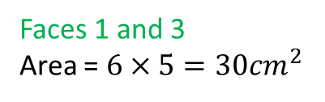
Rectangular Prism
Working
1
Area of each face
6 Faces
6 rectangles
3 sizes – 2 of each
Faces 1 and 3
Area = $6×5=30{cm}^{2}$
8 Vertices
Rectangular prism
5
2
12 Edges
6
Total Surface
Area (TSA)=
3
Total Surface Area =
Volume =
Volume =
4

Slide 23

Rectangular Prism
Working
1
Area of each face
6 Faces
6 rectangles
3 sizes – 2 of each
Faces 1 and 3
Area = $6×5=30{cm}^{2}$
8 Vertices
Faces 2 and 4
Area = $2×5=10{cm}^{2}$
Rectangular prism
5
2
12 Edges
6
Total Surface
Area (TSA)=
3
Total Surface Area =
Volume =
Volume =
4

Slide 24

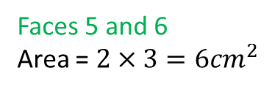

Rectangular Prism
Working
1
Area of each face
6 Faces
6 rectangles
3 sizes – 2 of each
Faces 1 and 3
Area = $6×5=30{cm}^{2}$
Faces 2 and 4
Area = $2×5=10{cm}^{2}$
8 Vertices
Rectangular prism
5
2
Faces 5 and 6
Area = $2×3=6{cm}^{2}$
12 Edges
6
Total Surface
Area (TSA)=
3
Total Surface Area =
Volume =
Volume =
4

Slide 25
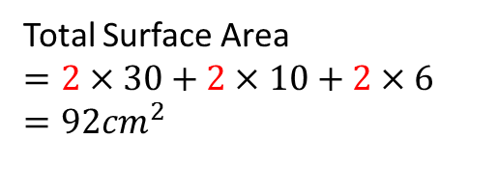
Rectangular Prism
Working
1
Area of each face
6 Faces
6 rectangles
3 sizes – 2 of each
Faces 1 and 3
Area = $6×5=30{cm}^{2}$
Faces 2 and 4
Area = $2×5=10{cm}^{2}$
8 Vertices
Rectangular prism
5
2
Faces 5 and 6
Area = $2×3=6{cm}^{2}$
12 Edges
6
Total Surface
Area (TSA)=
3
Total Surface Area
$$=2×30+2×10+2×6$$
$$=92{cm}^{2}$$
Volume =
Volume =
4

Slide 26


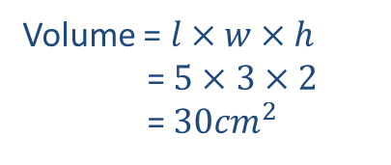
Rectangular Prism
Working
1
Area of each face
6 Faces
6 rectangles
3 sizes – 2 of each
Faces 1 and 3
Area = $3×5=15{cm}^{2}$
Faces 2 and 4
Area = $2×5=10{cm}^{2}$
8 Vertices
Rectangular prism
5
2
Faces 5 and 6
Area = $2×3=6{cm}^{2}$
12 Edges
6
Total Surface
Area (TSA)=
3
Total Surface Area
$$=2×15+2×10+2×6$$
$$=62{cm}^{2}$$
Volume = $l×w×h$
= $5×3×2$
= $30{cm}^{2}$
Volume =
4

Slide 27
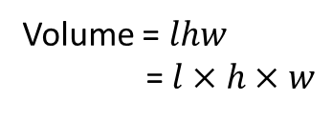
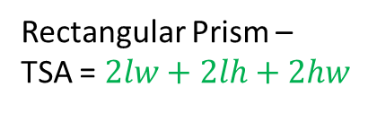



24
7
30
Date
Cubes and Rectangular Prisms
EQ – How is a net of a 3-D shape used to find the surface area and volume of a rectangular prism?
$$h$$
$$w$$
$$l$$
To find the surface area you add together the areas of all the faces
TSA is Total Surface Area
Rectangular Prism –
TSA = $2lw+2lh+2hw$
2 x each size rectangle
Volume = $lhw$
= $l×h×w$
19

Slide 28
Questions

Slide 29
24
7
30
Date
Cubes and Rectangular Prisms
EQ – How is a net of a 3-D shape used to find the surface area and volume of a rectangular prism?
What is a net?
A net is a 2-D picture that folds to make a 3-D shape.
What are the part s of a 3-D shape called?
Edge
Vertex
Face
19

Slide 30
24
7
30
Date
Cubes and Rectangular Prisms
EQ – How is a net of a 3-D shape used to find the surface area and volume of a rectangular prism?
How do you find the TSA and volume of a cube?
$$l$$
To find the surface area you add together the areas of all the faces
TSA is Total Surface Area
Cube –
TSA = $6×l^{2}$
Number of faces x
Area of each face
Volume = $l^{3}$
19

Slide 31
24
7
30
Date
Cubes and Rectangular Prisms
EQ – How is a net of a 3-D shape used to find the surface area and volume of a rectangular prism?
How do you find the TSA and volume of a rectangular prism?
$$h$$
$$w$$
$$l$$
To find the surface area you add together the areas of all the faces
TSA is Total Surface Area
Rectangular Prism –
TSA = $2lw+2lh+2hw$
2 x each size rectangle
Volume = $lhw$
= $l×h×w$
19

Slide 32
Notes Review
24, 7 ,30
Date
Title
Essential question
Notes complete
Notes complete with colour and diagrams
Questions completed
Contents page filed in
Formula page filled in

Slide 33
Homework
Review your notes and write a summary answering the essential question.

Slide 34
Plenary
Draw three shapes with a perimeter of 36cm.

